Slide 1
Monash University Fintech Boot Camp – Project 3
Trading based on Conditional Drawdown and Risk and the efficient frontier
Joshua Woods
David Lewis
Matthew Tsiglopoulos

Slide 2

Motivation/Summary
1
2
3
How can we best trade in a live environment without taking on too much drawdown risk?
How does this compare to classical Modern Portfolio Theory and the efficient mean-variance frontier
Questions
Can we factor in drawdown risk to an efficient portfolio?
Core Motivation
To trade live data on Meta Trader. Motivated by Josh’s trading strategies.
3 Stage Analysis
Obtain historical data from stocks Josh has used to trade, convert to AUD
Utilize Modern Portfolio theory applied to cDaR to obtain an efficient portfolio
Compare weightings to weightings obtained using classic MPT and the mean-variance efficient frontier
Analysis
A monthly suburb highlight, blooming and booming the city once again
Findings
No shorts and FX had the weakest results. Applying both had the strongest
CDaR provided a new sense to analyse risk, and corresponding returns

Slide 3



1
2
3
Data Collection
Create an optimal CDaR portfolio
Compare
Utilised MetaTrader API to collect 10 year historical data for various indices and CFD’s including gold, silver, crude oil.
Convert each to AUD on a daily basis
Compare this portfolio to the usual mean-variance efficient portfolio
Apply Modern Portfolio Theory, with the aim of minimising CDaR to obtain an efficient portfolio based on historical data

Slide 4
| Data Used

Slide 5
Questions and Data
Our Methodology
Model 1
Model 2
MPT portfolio (mean-variance) with and w/o shorts
MPT portfolio minimising CDaR (with and w/o shorts and FX)
Import the data from MetaTrader
Convert data to AUD
Apply the PyPortfolioOpt library on data
Fit to mazimize mean-variance according to variance of first model
Analyse outputs including mean return, variance, CDaR
Import the data from MetaTrader
Convert data to AUD
Apply the PyPortfolioOpt library on data
Fit to minimise CDaR
Analyse outputs including mean return, variance, CDaR
Data Used
Data Used
Used 10 year historical closing price data for the following indices and CFDs
Silver Spot
Gold spot
Crude Oil spot
Dow jones industrial average index
Russell mid cap index
S&P 500
Various geographical indices
Used 10 year historical closing price data for the following indices and CFDs
Silver Spot
Gold spot
Crude Oil spot
Dow jones industrial average index
Russell mid cap index
S&P 500
Various geographical indices

Slide 6
Data Cleanup/Preparation
Data Clean Up/Preparation | Why we did this
We import data from MetaTrader (in different currencies | Used MetaTrader data to get closer to real world trading scenario and simulate trading on live platform with a drawdown requirement
Import AUD cross-currency rates from MetaTrader | To convert back to AUD to have real returns of trading strategy
Multiply stock and CFD data by relevant AUD cross-currency rates | To convert back to AUD to have real returns of trading strategy
Used 10 years of historical data | To ensure a long enough time horizon to accurately test data and obtain periods of volatility

Slide 7
| Analysis

Slide 8
Mean-variance efficient portfolio – Max Sharpe, No shorts or FOREX. AUD prices.

Slide 9
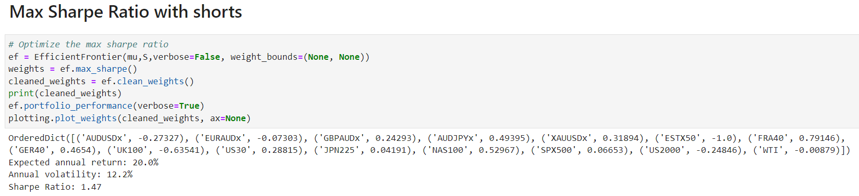
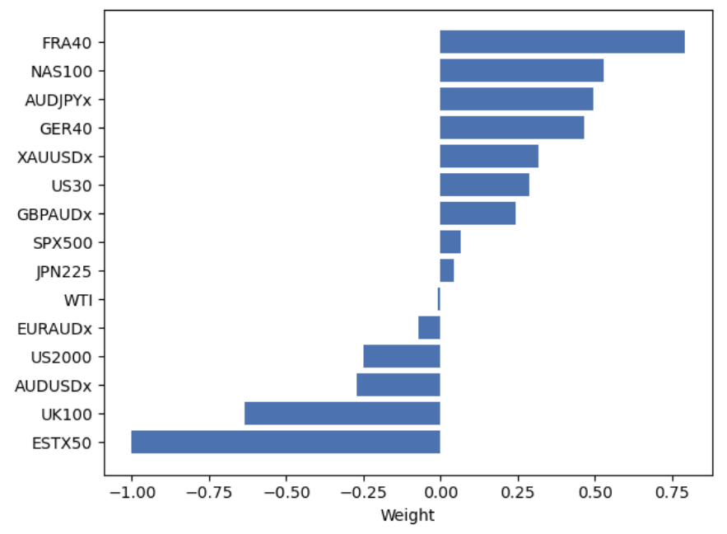
Mean-variance efficient portfolio – Max Sharpe, Shorts and Forex. AUD prices.

Slide 10
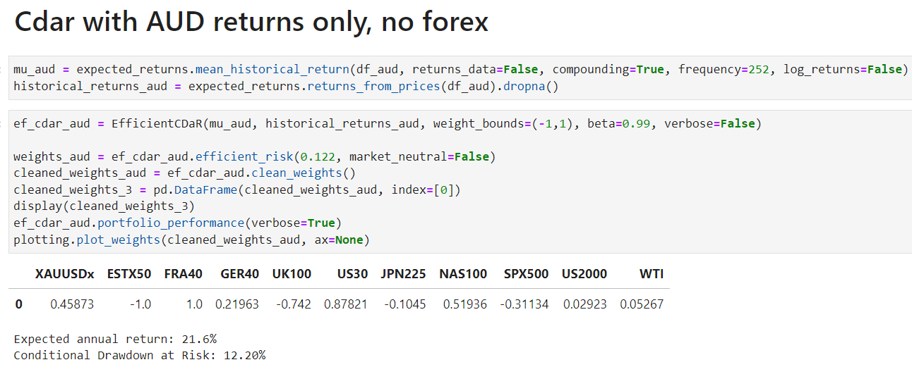
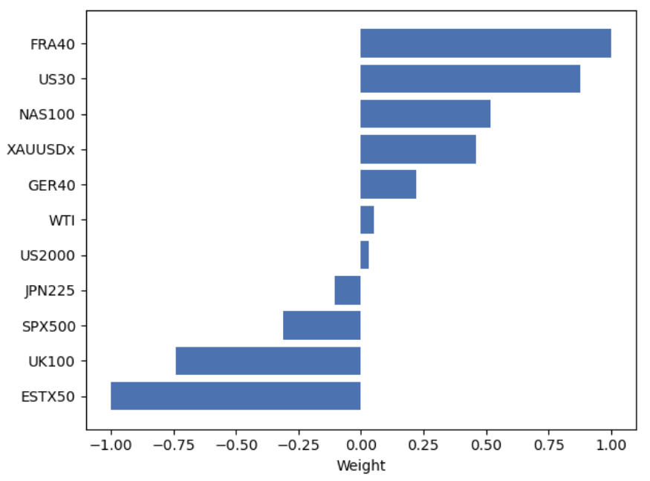
CDaR Efficient Portfolio – CDaR Optimiser, Shorts and No Forex

Slide 11
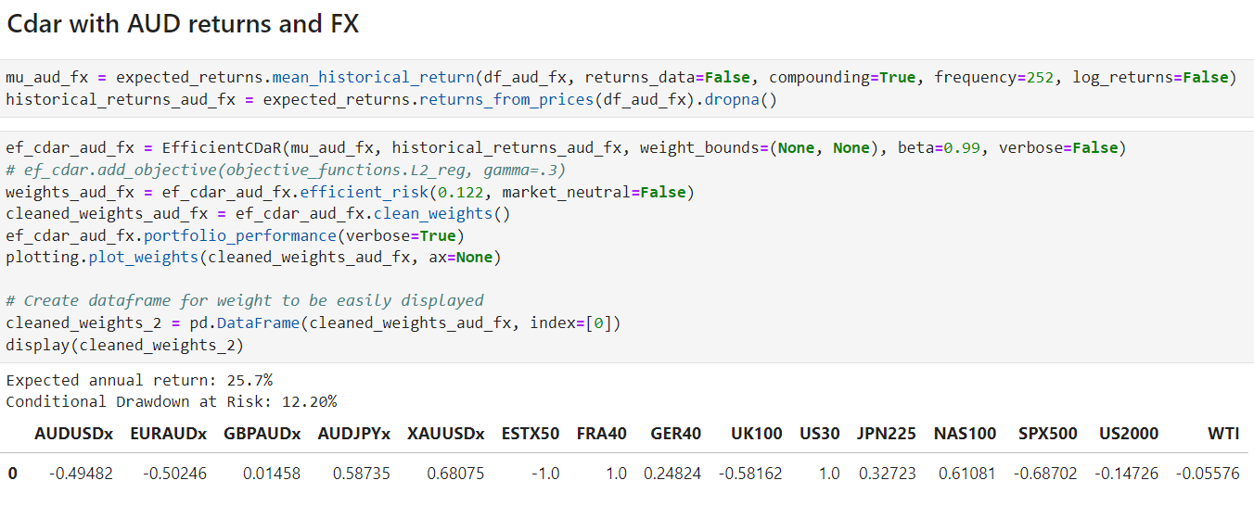
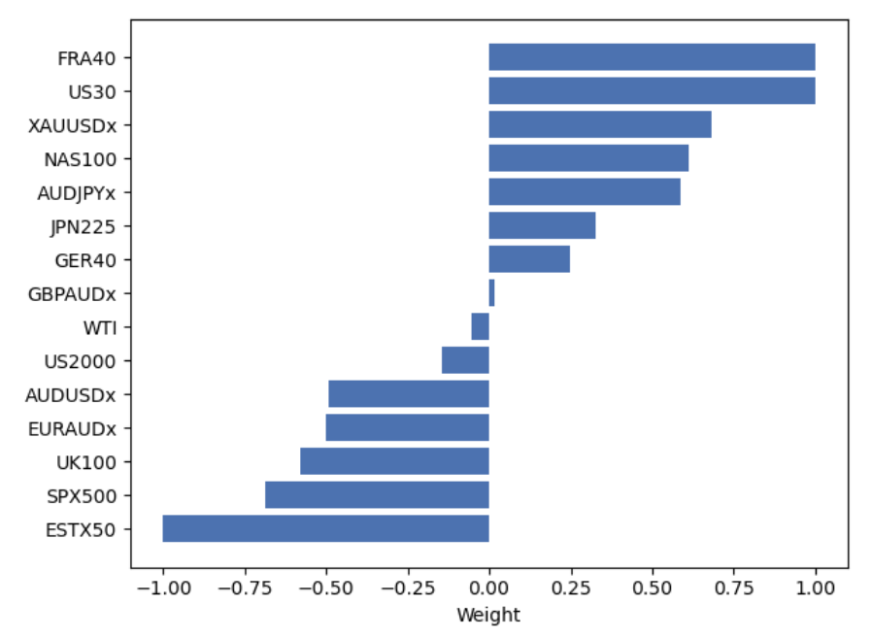
CDaR efficient Portfolio – CDaR optimiser, Shorts and Forex. AUD prices.

Slide 12
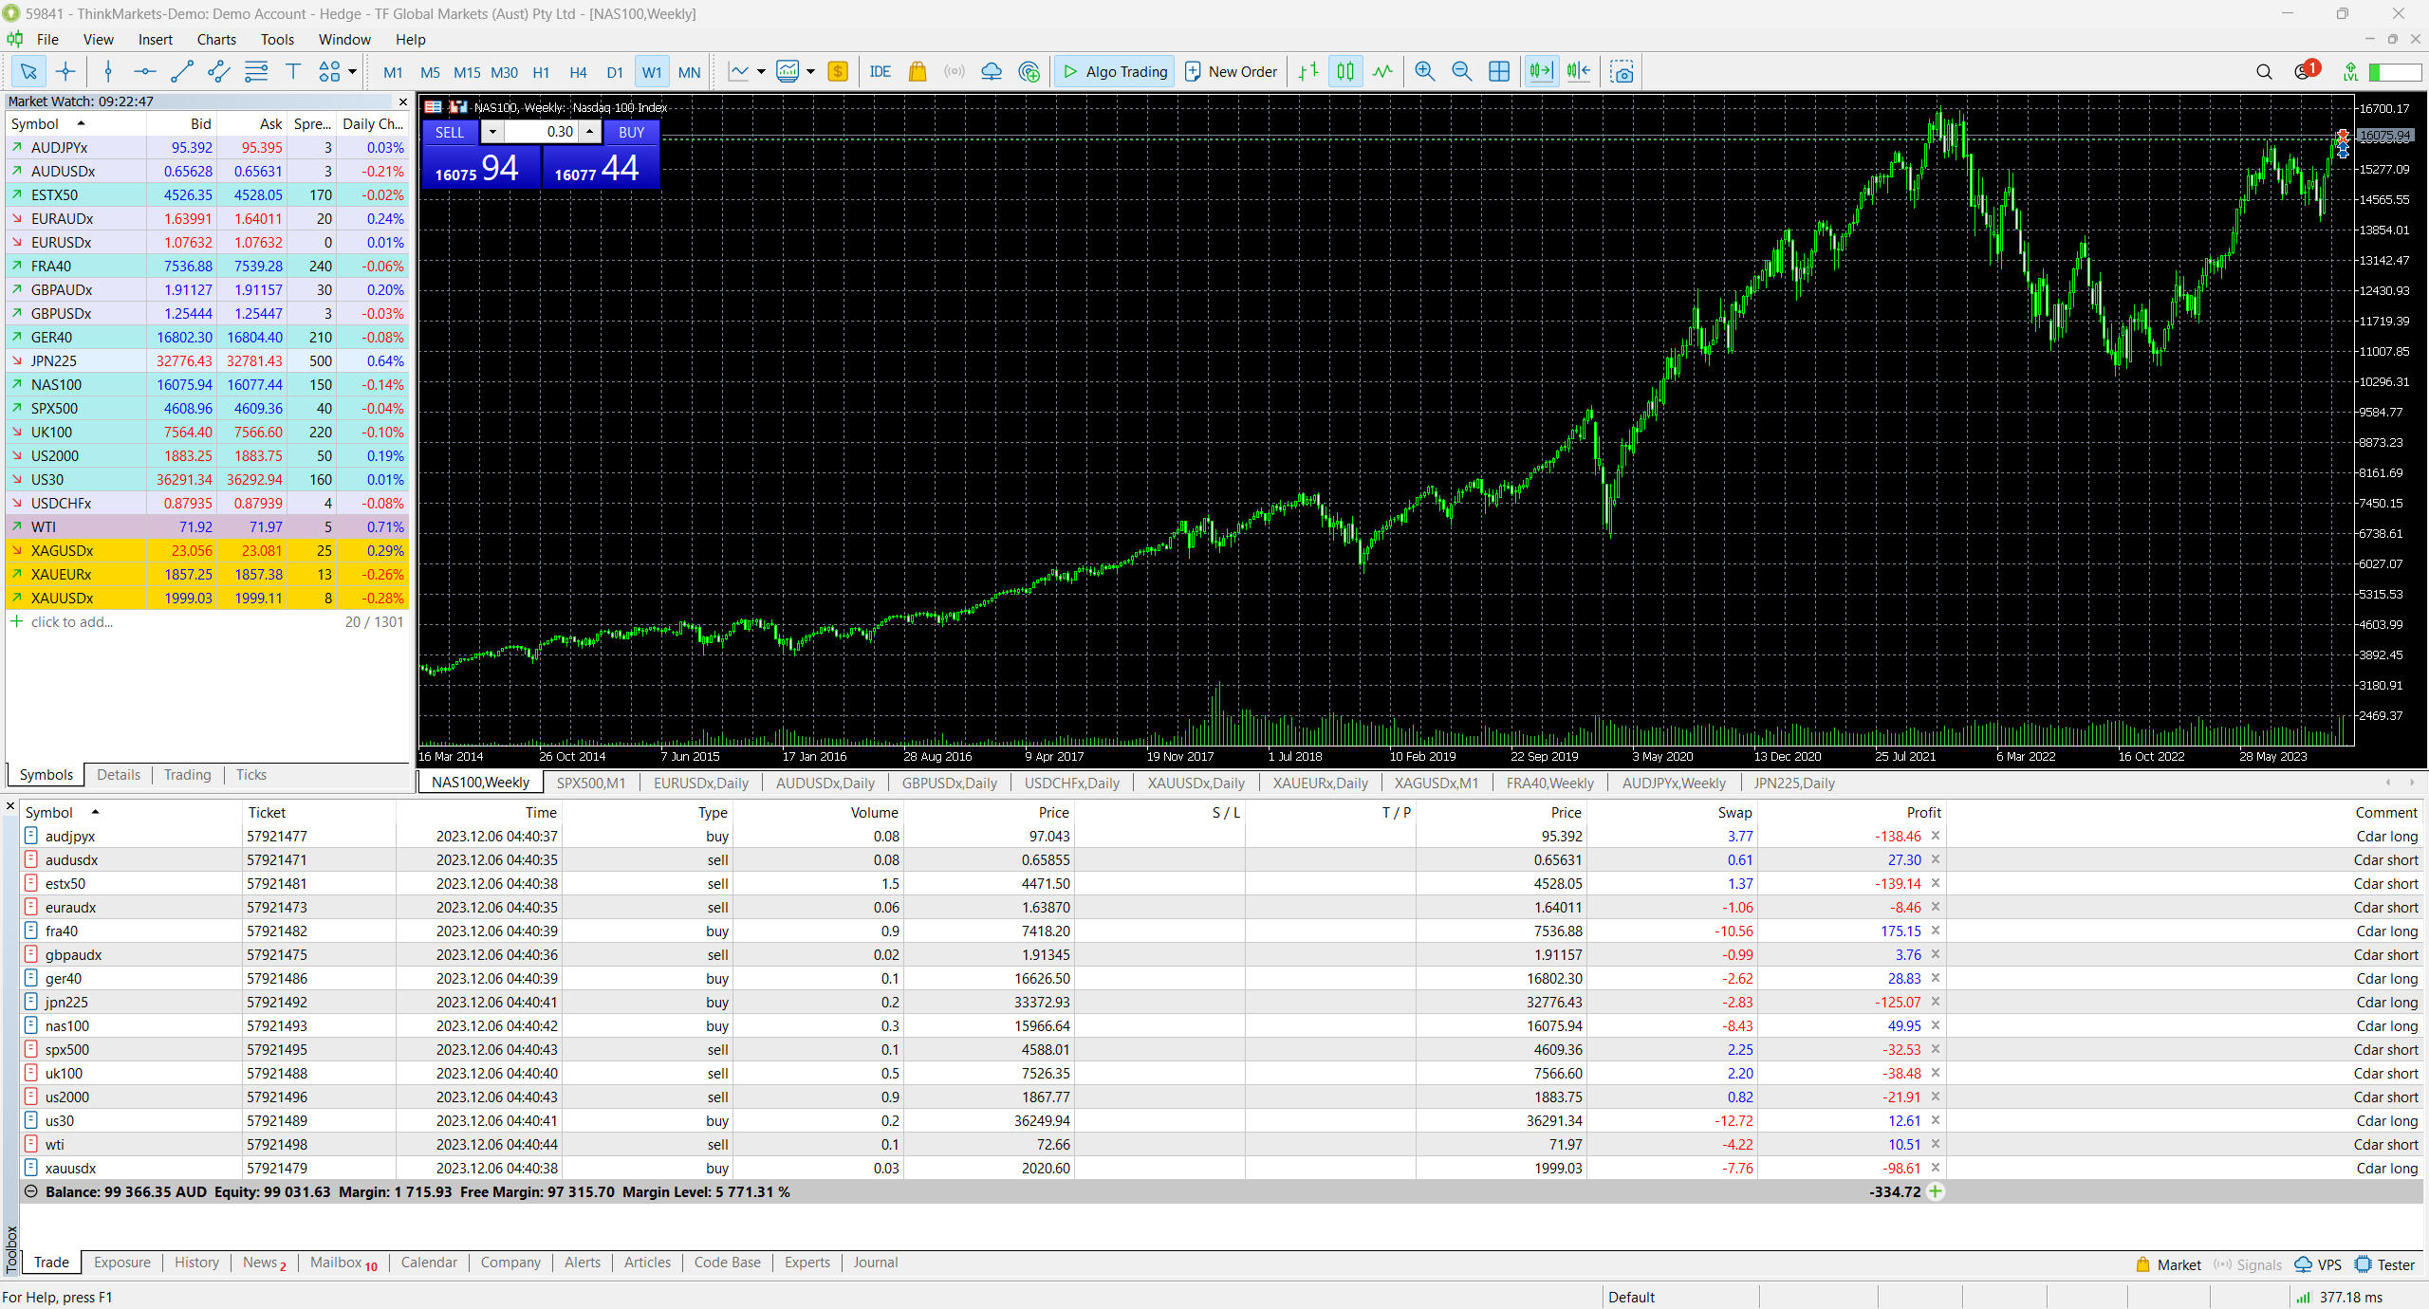
DEMO

Slide 13
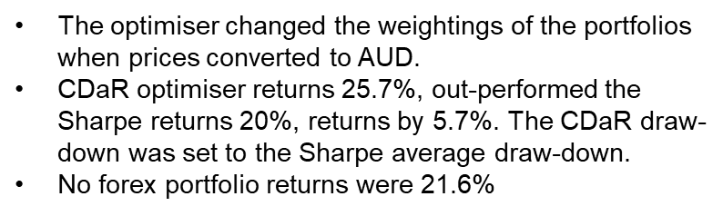

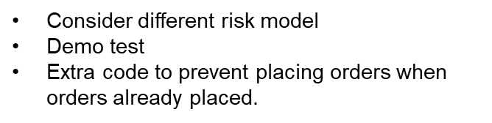
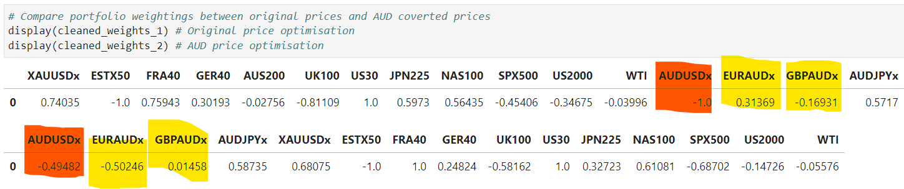
Discussion/postmortem
Findings
Project Difficulties
Future Steps

